Slide 1
Sleep Health and Lifestyle
M2M TECH
DataTalent Program
CP 1 and 2
Veronika Ulianova, March 17, 2025

Slide 2

https://www.sleephealth.org/

Slide 3
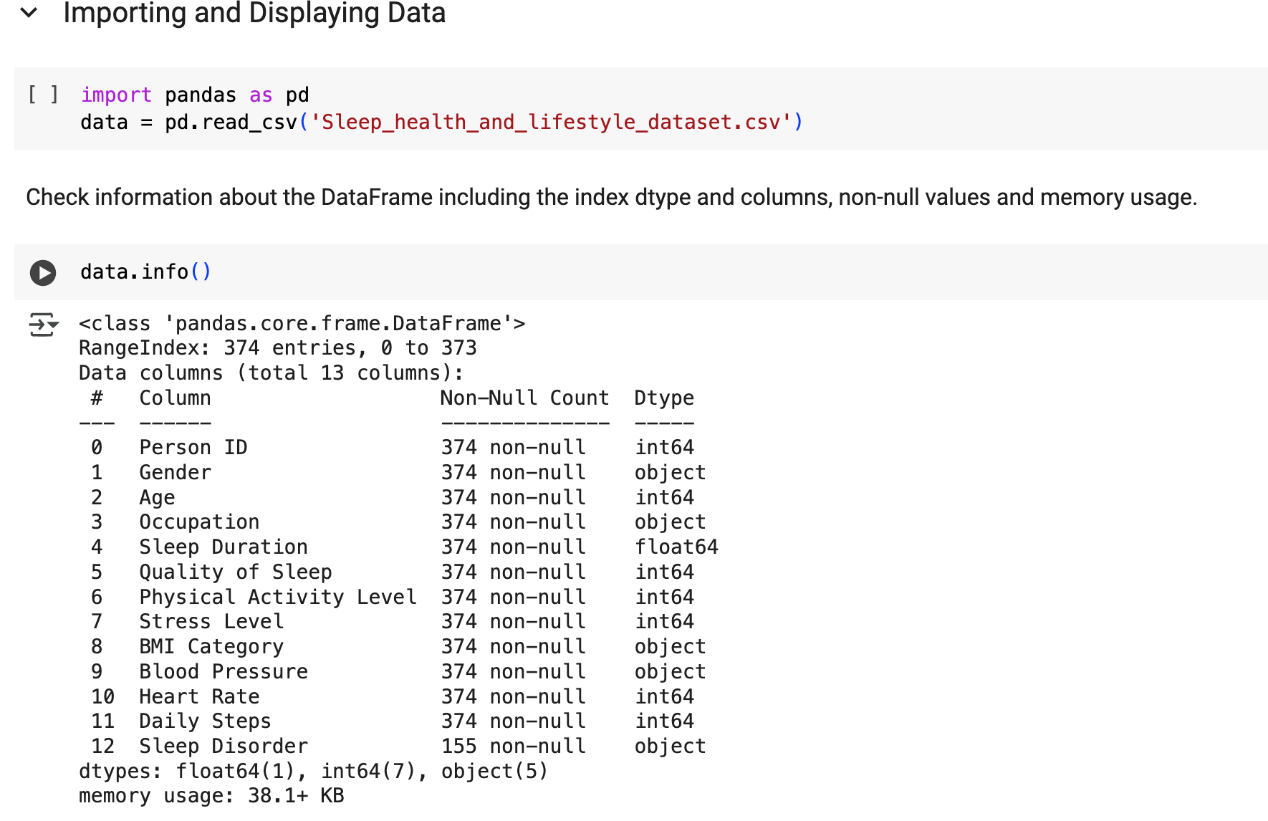
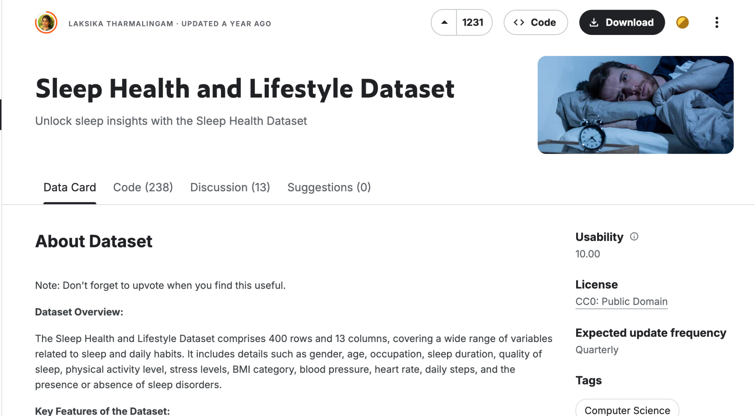
Data

Slide 4
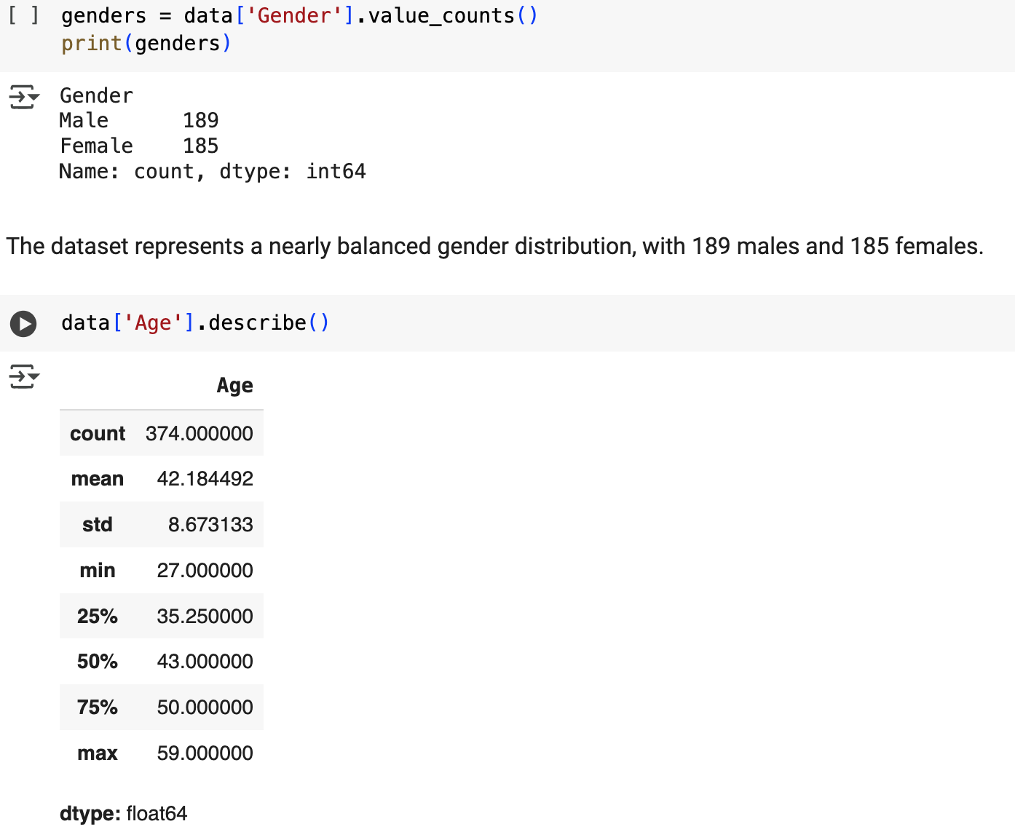
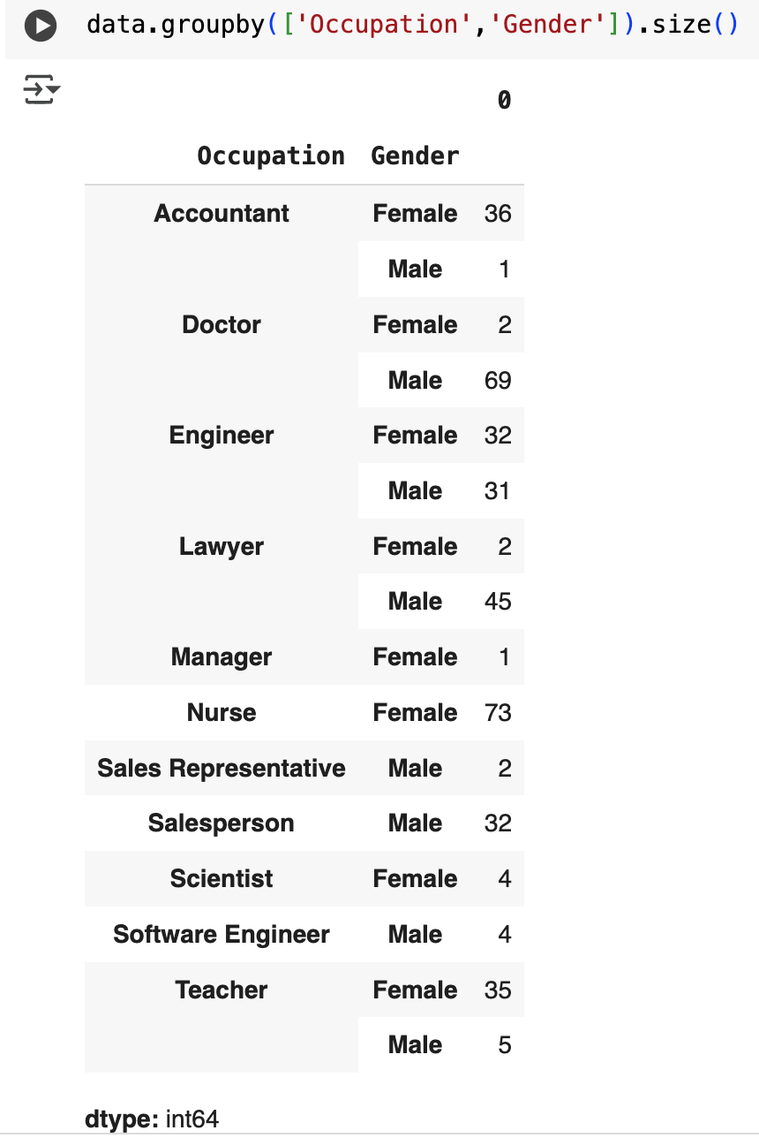
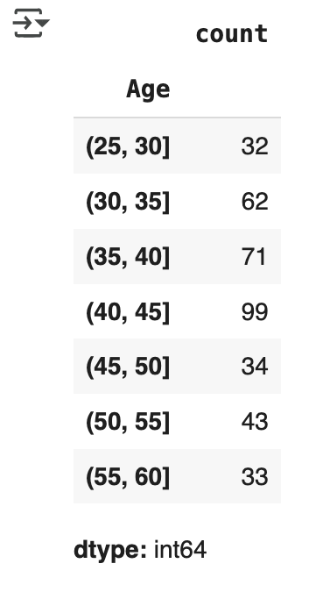
Understanding the gender, age and occupation data
nearly balanced gender distribution
a majority of participants in the 30-50 years age range.
nurses, teachers, and accountants are predominantly female, while doctors, lawyers, and salespersons are largely male.
engineers show more gender balance, scientists, software engineers, sales representatives and managers are underrepresented.

Slide 5
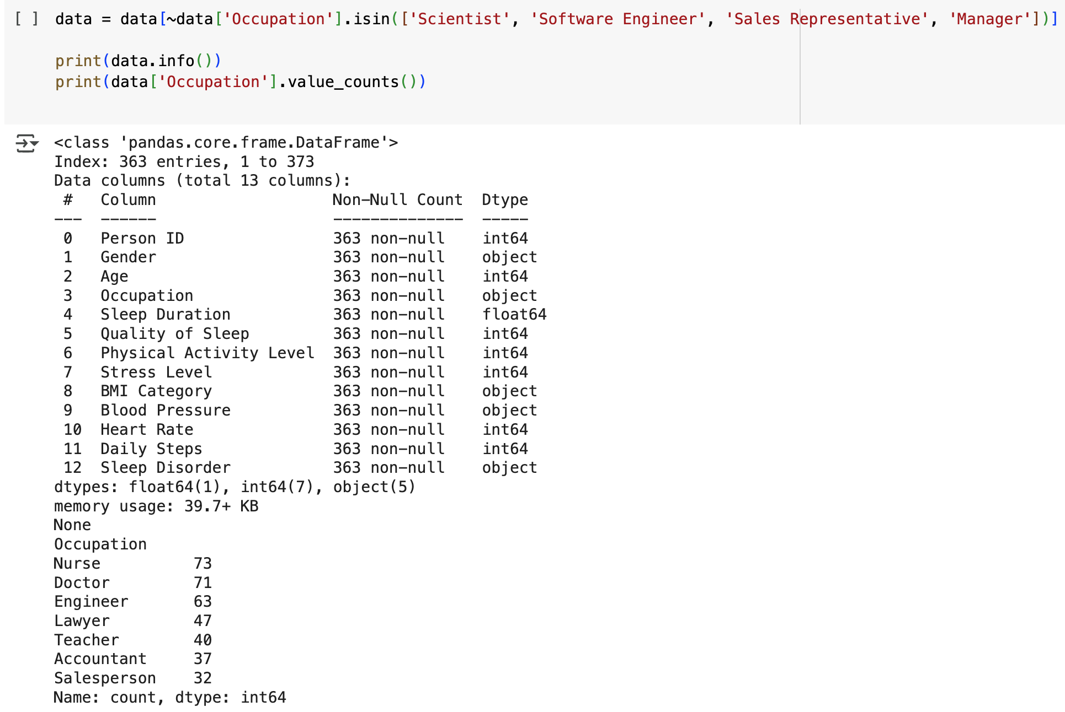
Assumption to exclude underrepresented groups

Slide 6
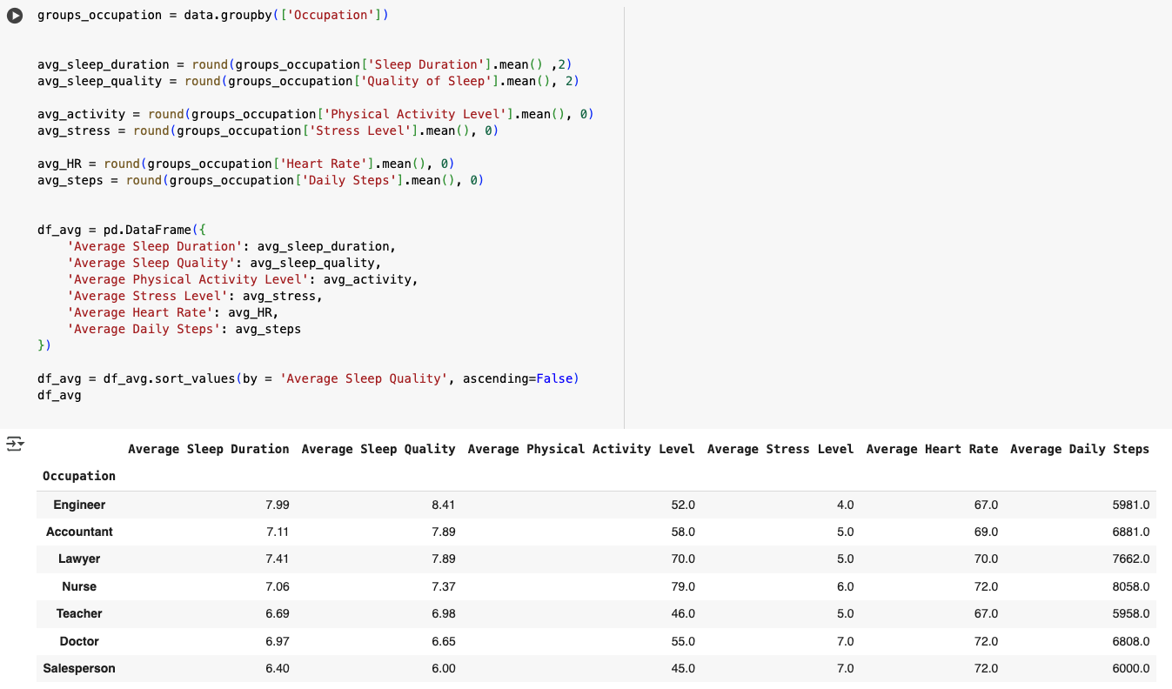
Analysis of the sleep parameters and lifestyle for each occupation

Slide 7
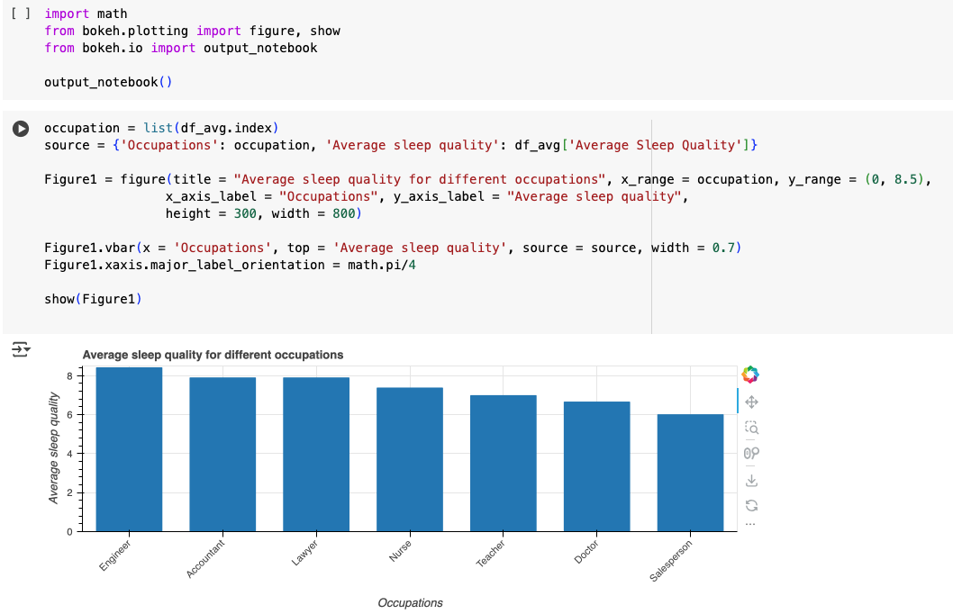
Analysis of the sleep parameters and lifestyle for each occupation

Slide 8
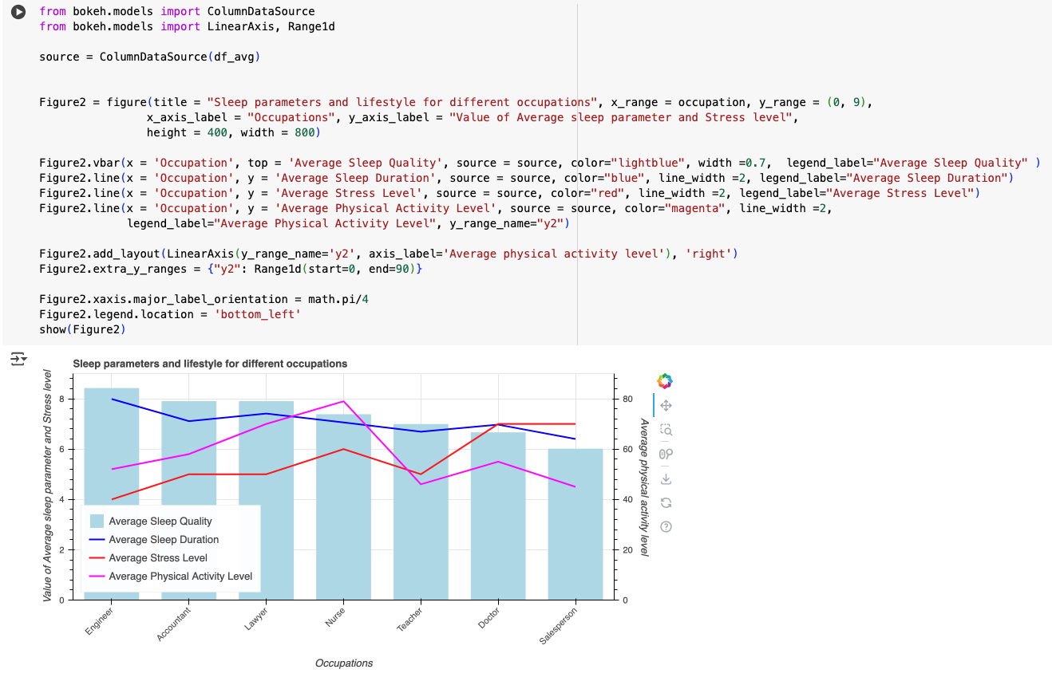
Analysis of the sleep parameters and lifestyle for each occupation

Slide 9
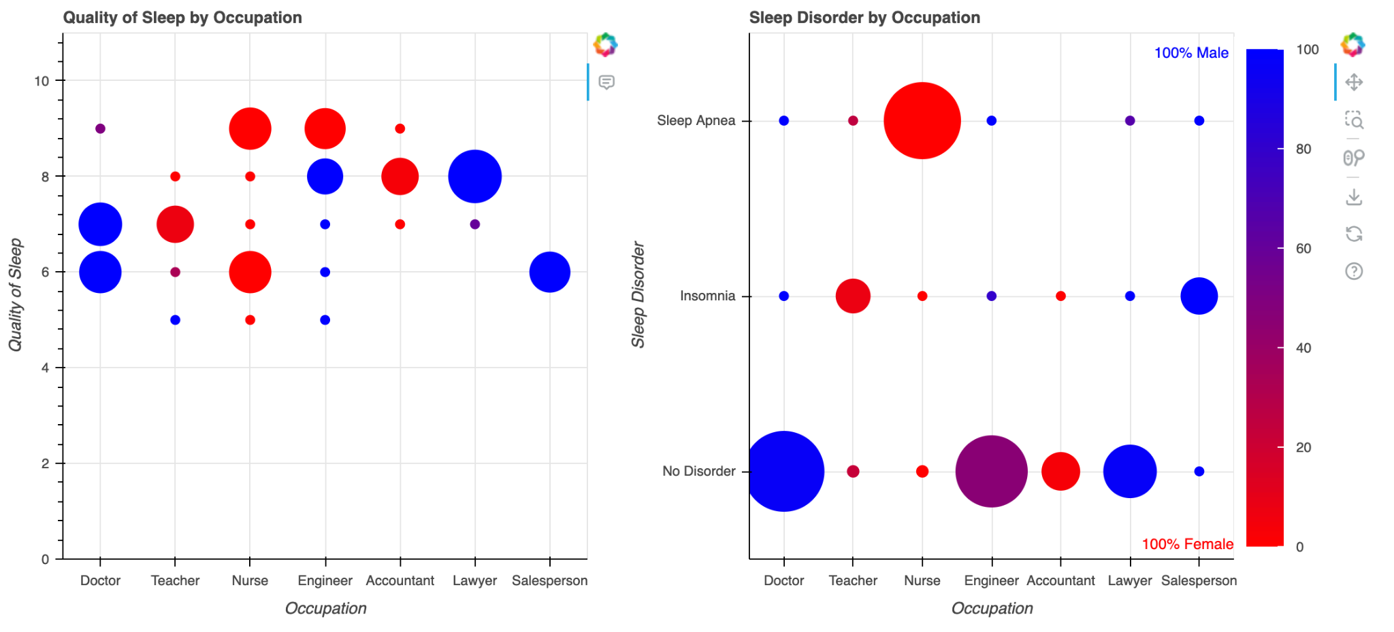
Visualization of Lifestyle and Sleep Disorders for Male and Female Participants

Slide 10
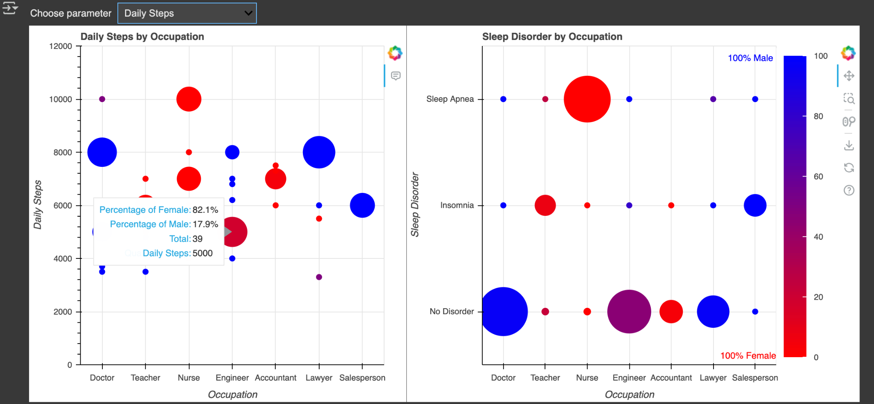
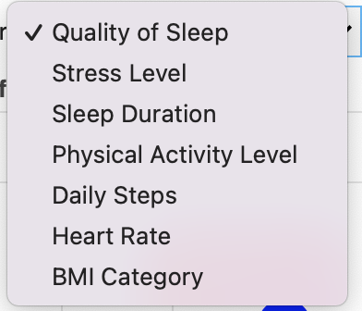
Visualization of Lifestyle and Sleep Disorders for Male and Female Participants

Slide 11
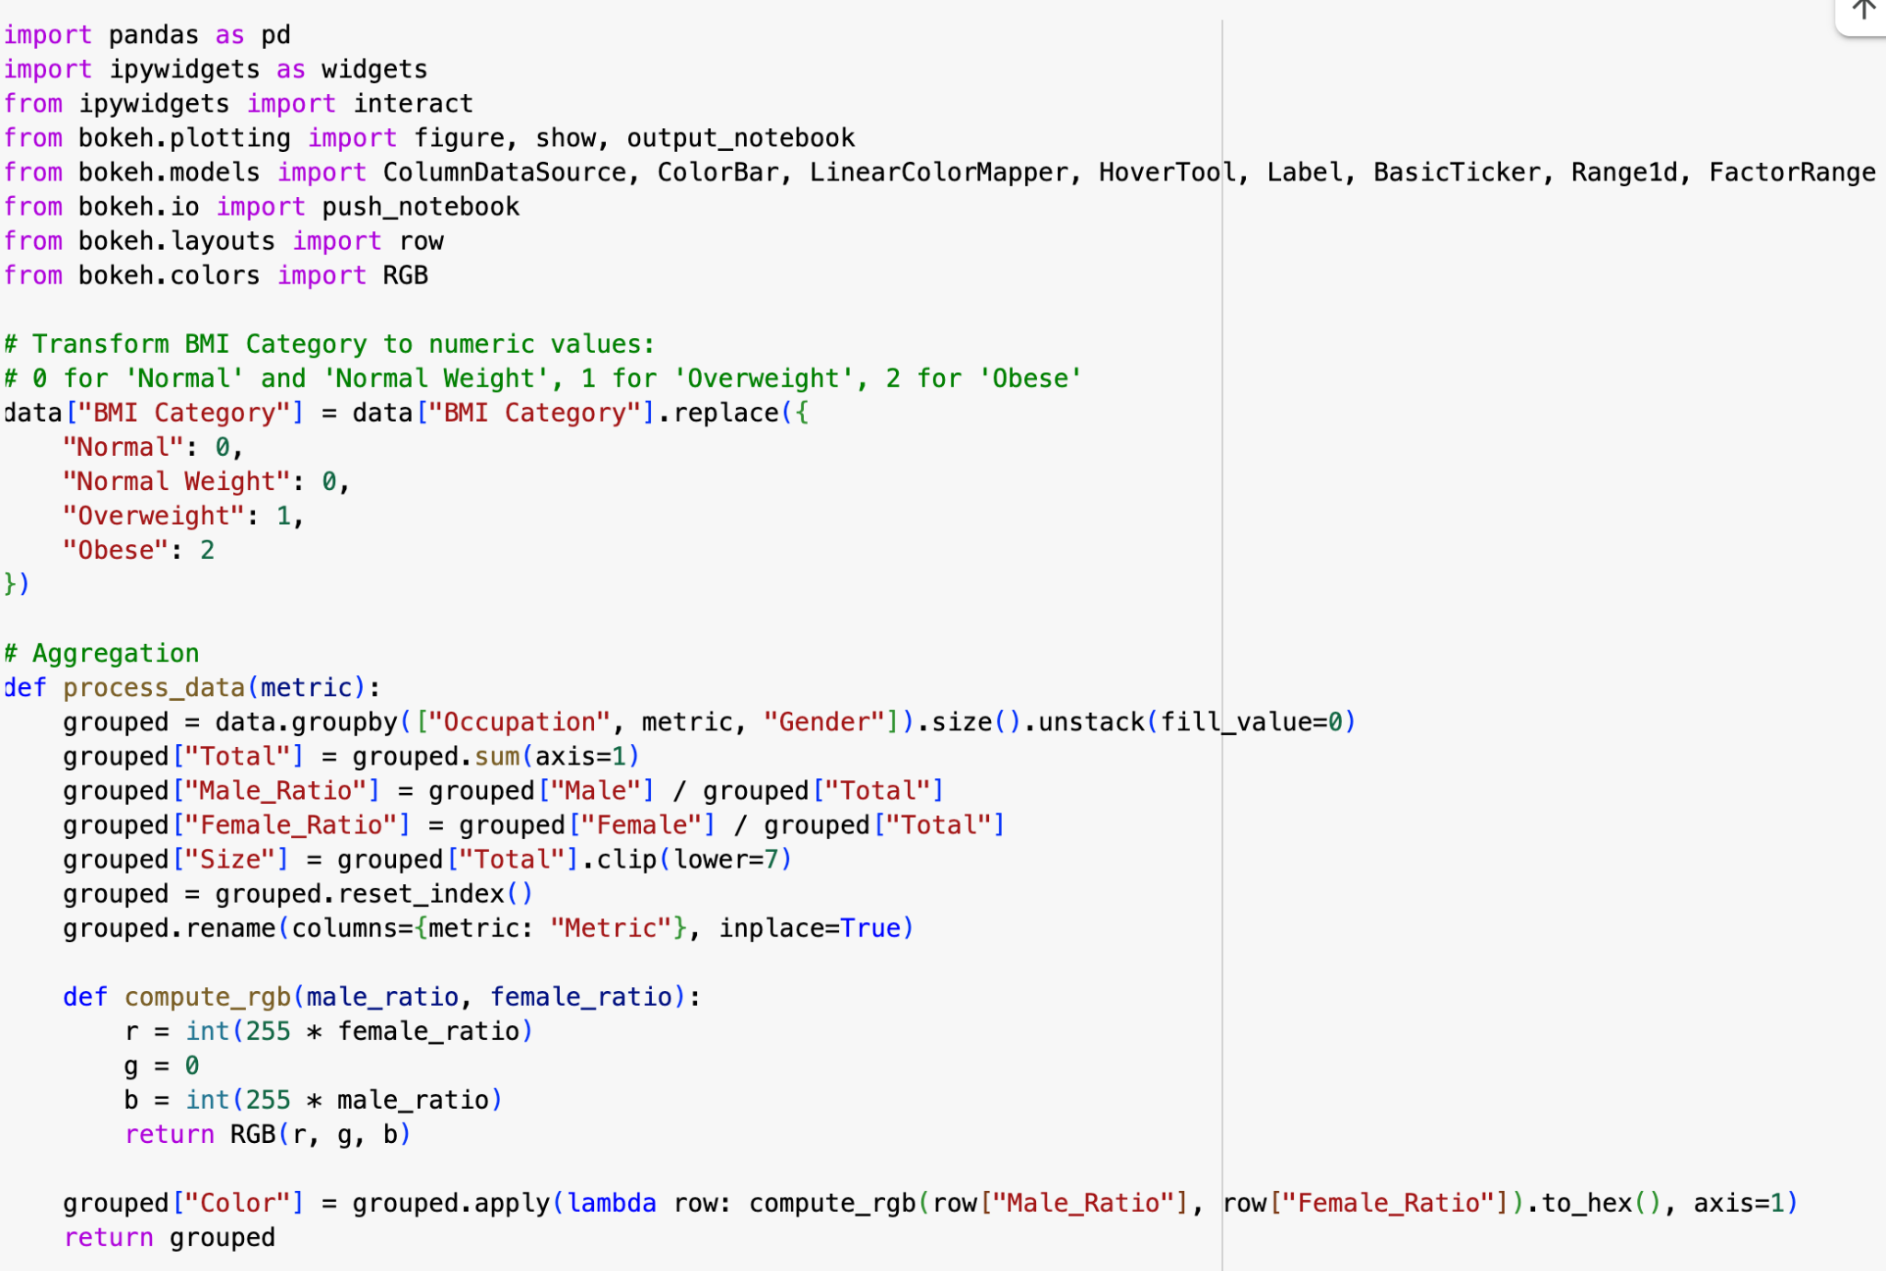
Visualization of Lifestyle and Sleep Disorders for Male and Female Participants

Slide 12
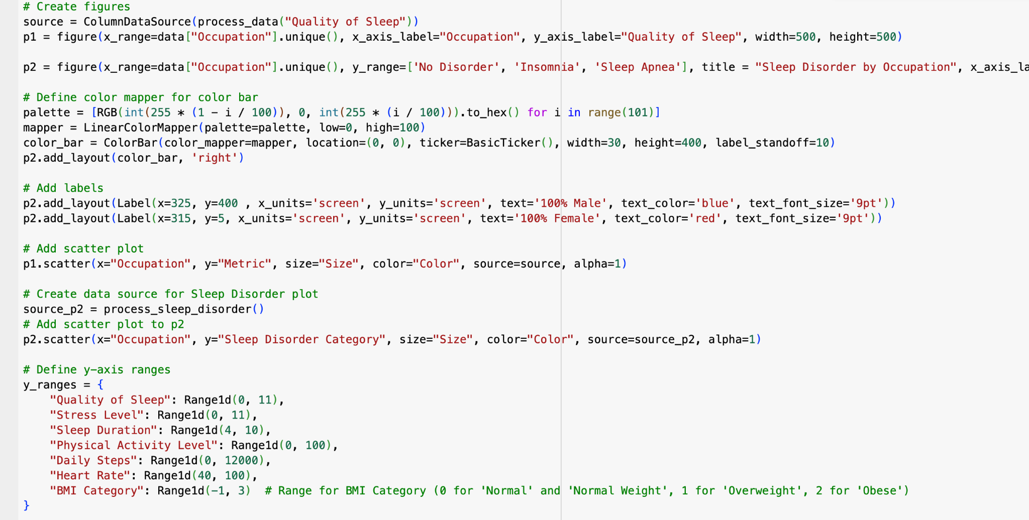
Visualization of Lifestyle and Sleep Disorders for Male and Female Participants

Slide 13
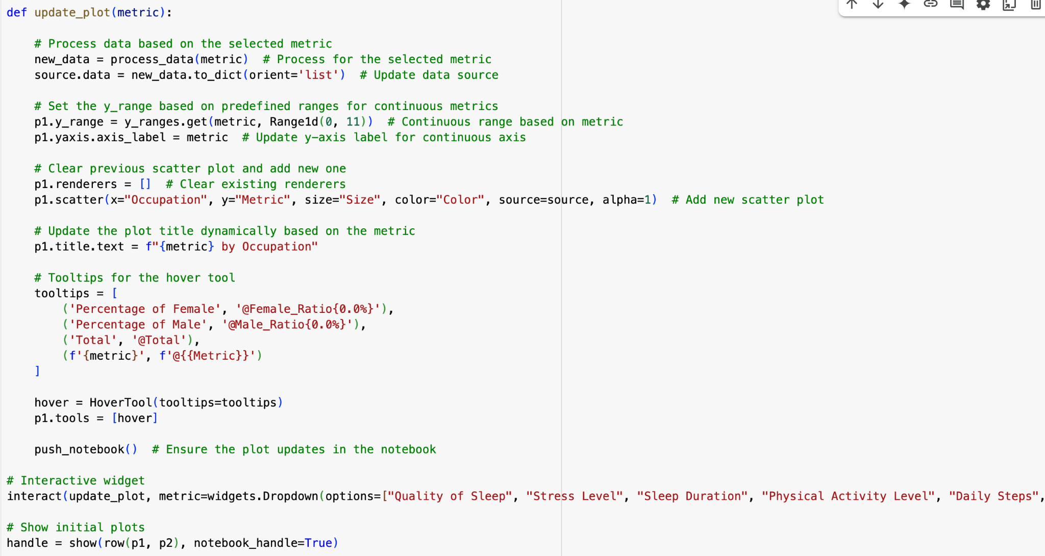
Visualization of Lifestyle and Sleep Disorders for Male and Female Participants

Slide 14
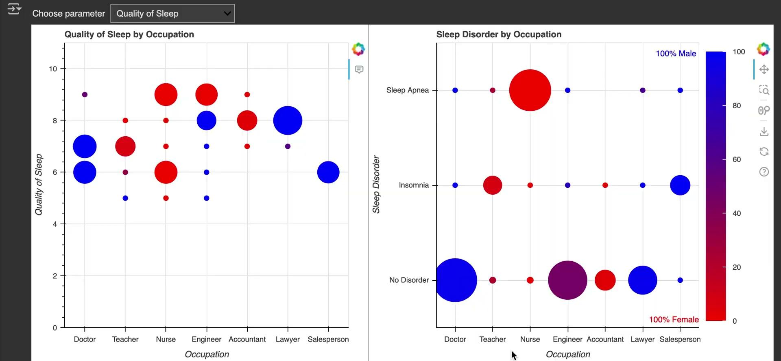

Visualization of Lifestyle and Sleep Disorders for Male and Female Participants ParticipantsParticipants

Slide 15
Conclusion
Female participants have better Quality of Sleep and lower Stress Level in most Occupation groups.
Physical activity level, Daily steps and Heart Rate are higher for Male participants.
BMI Category is the most important parameter for Sleep Disorder.

Slide 16
Thank you!

Slide 17
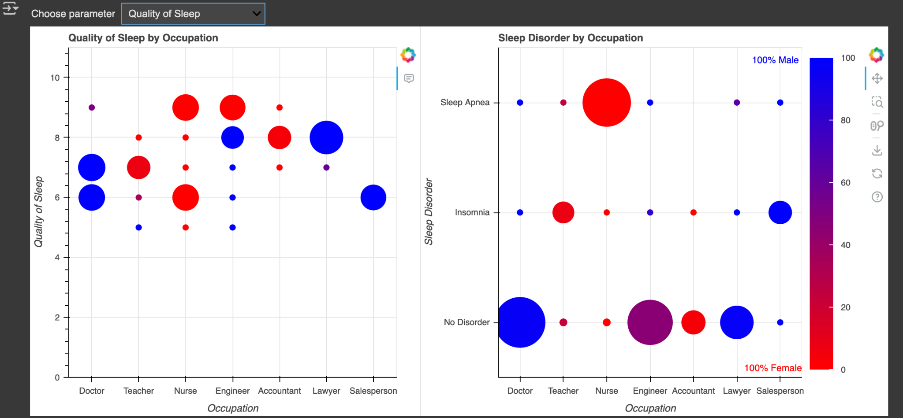

Slide 18
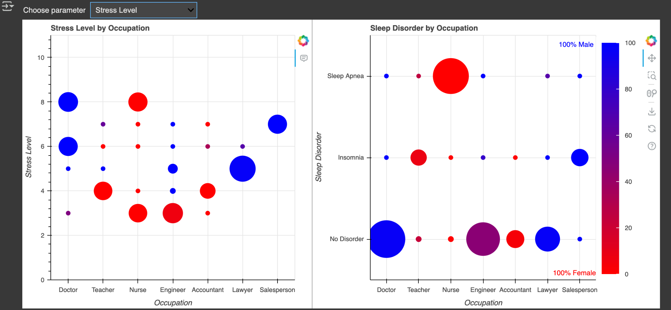

Slide 19
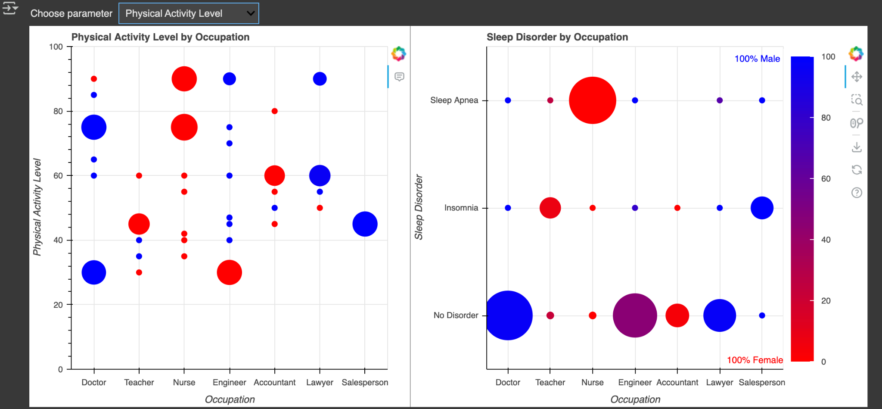

Slide 20
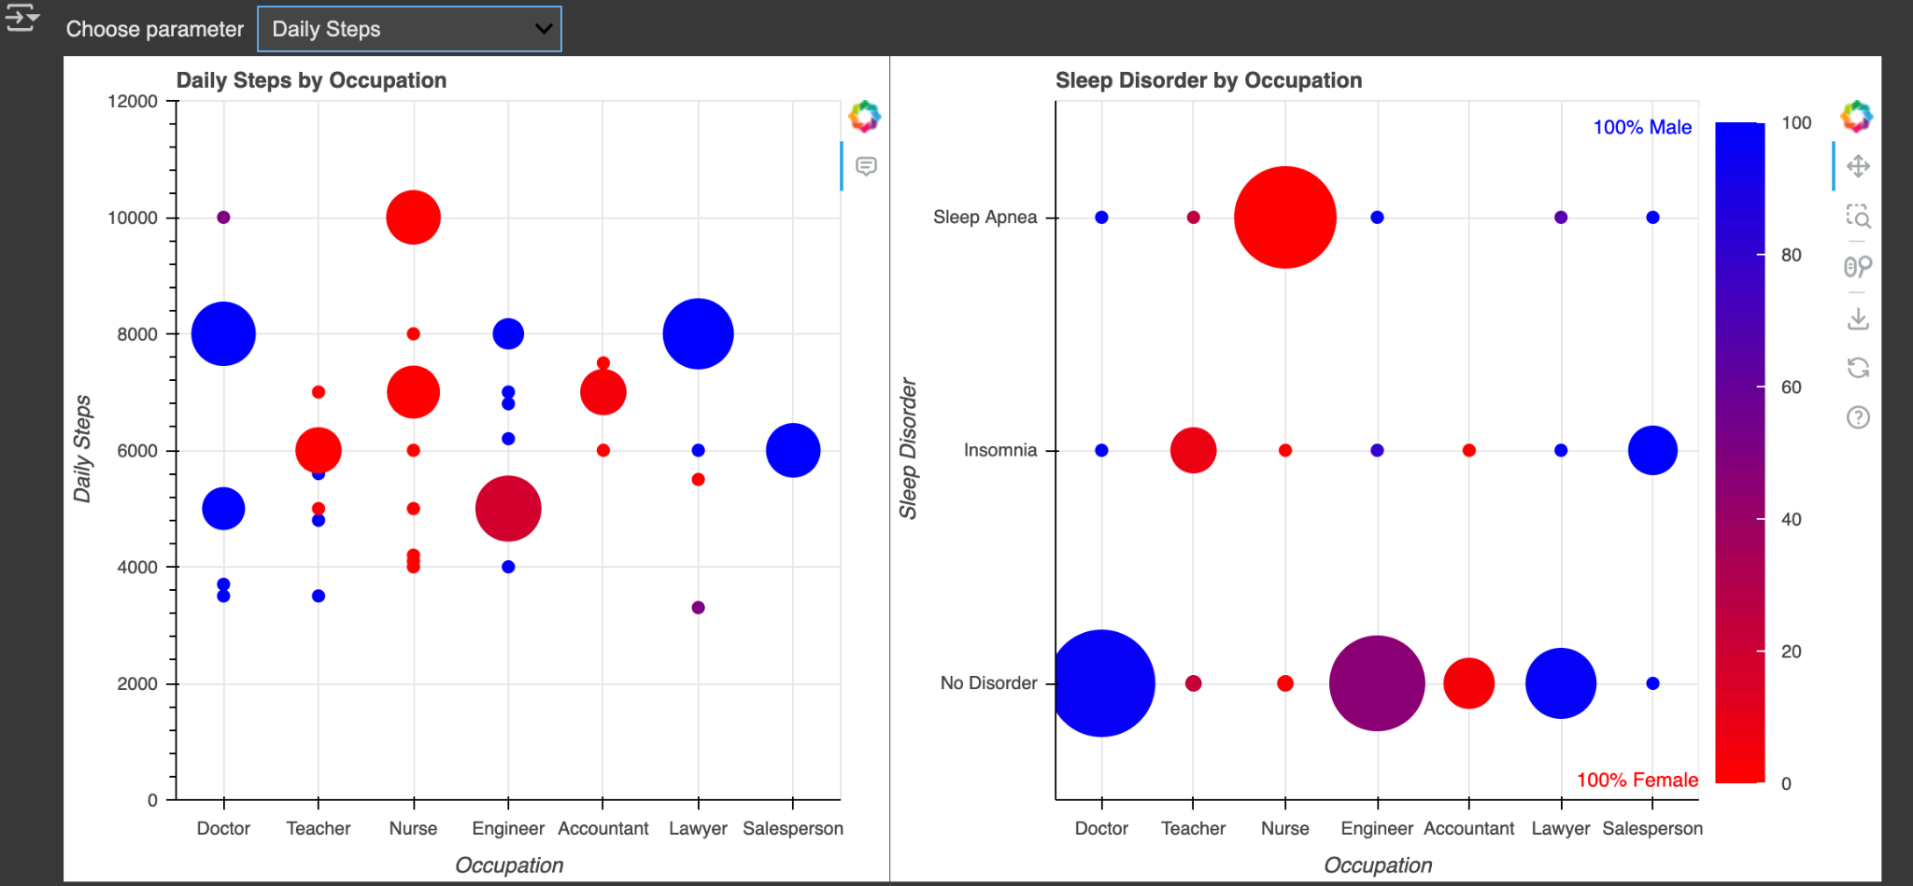

Slide 21
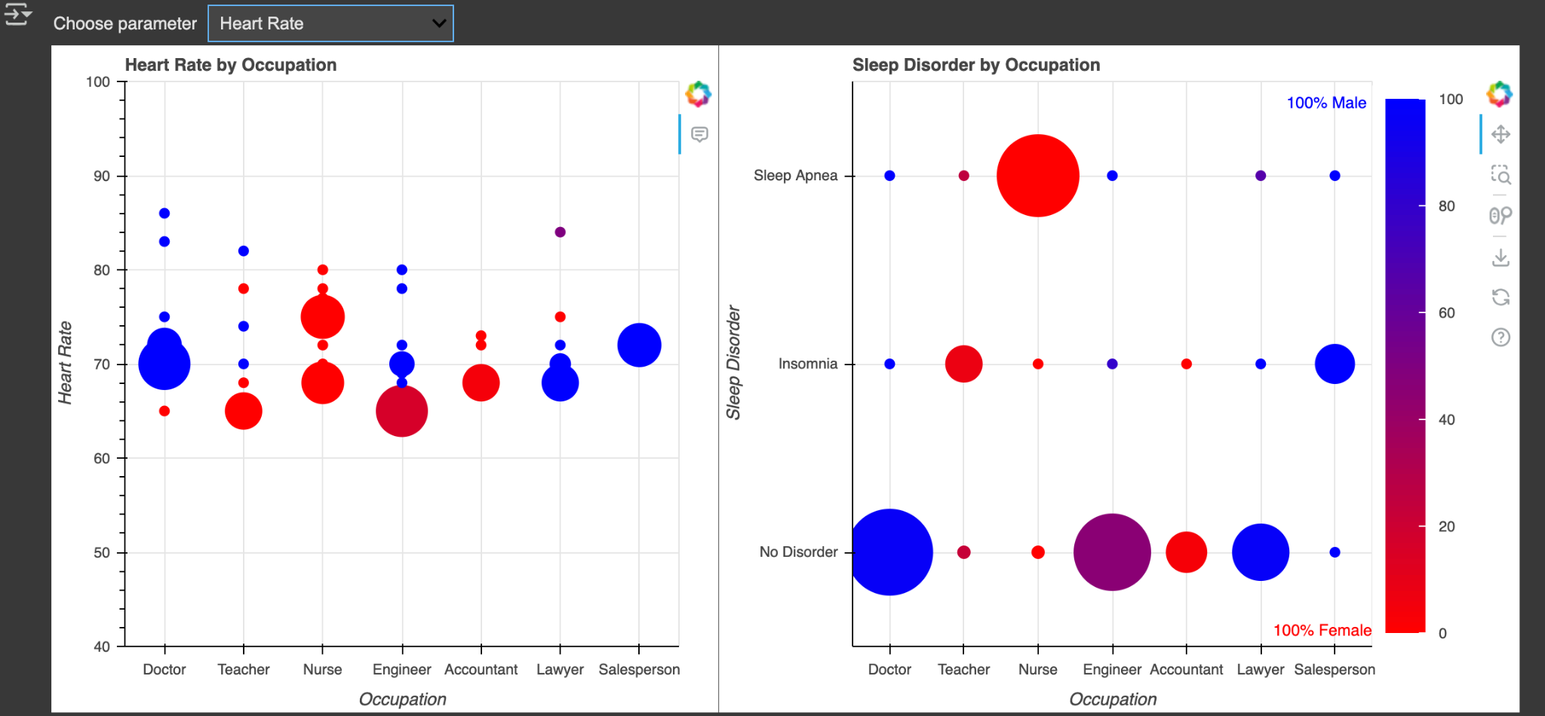

Slide 22
